Slide 1
Exploring the Potential of Large Language Models in Healthcare
Supervisor: Prof Hussain Ahmad
7104A Research Project
Master of Computer Science
Subin Pulliyil Santhosh A1917668
5 June 2025

Slide 2
Agenda Overview
Introduction
Literature Review
Research Gap
Research Questions
Research Outcome
Methodology
Research Progress
Timeline
Initial Implementation
Future Work

Slide 3
Introduction - Background
AI is reshaping the healthcare sector.
LLMs: ChatGPT, GROK, Gemini, LLaMA, ChatDoctor, etc.
Use cases:
Answering patient queries.
Summarising clinical notes.

Slide 4
Introduction - Motivation
LLMs are advanced but they can make mistakes called ‘hallucinations’.
Traditional systems lack accuracy.
Reliable, accurate and updated information is a must for healthcare systems.
Can we trust LLMs in healthcare tasks?

Slide 5
Literature Review
LLMs can pass medical exams.
Domain-specific models (eg. ChatDoctor) performs better.
Common issues:
Lack of real-world testing.
Inaccuracy in complex cases.
Outdated datasets used in evaluations.

Slide 6
Research Gap
Limited studies and research on healthcare implementations of models like GROK, Gemini, LLaMa, etc.
Few comparisons between general vs domain-specific models.
Need for updated datasets.
Lack of real-world testing.

Slide 7
Research Questions
1. How can LLMs be used in healthcare tasks?
2. What are their strengths and weaknesses?
3. What risks are involved and how can we reduce them?

Slide 8
Research Outcome
Compare various LLM’s output on healthcare-based queries.
Relationship between faster results and accurate results.
Replace/assist everyday healthcare queries.

Slide 9
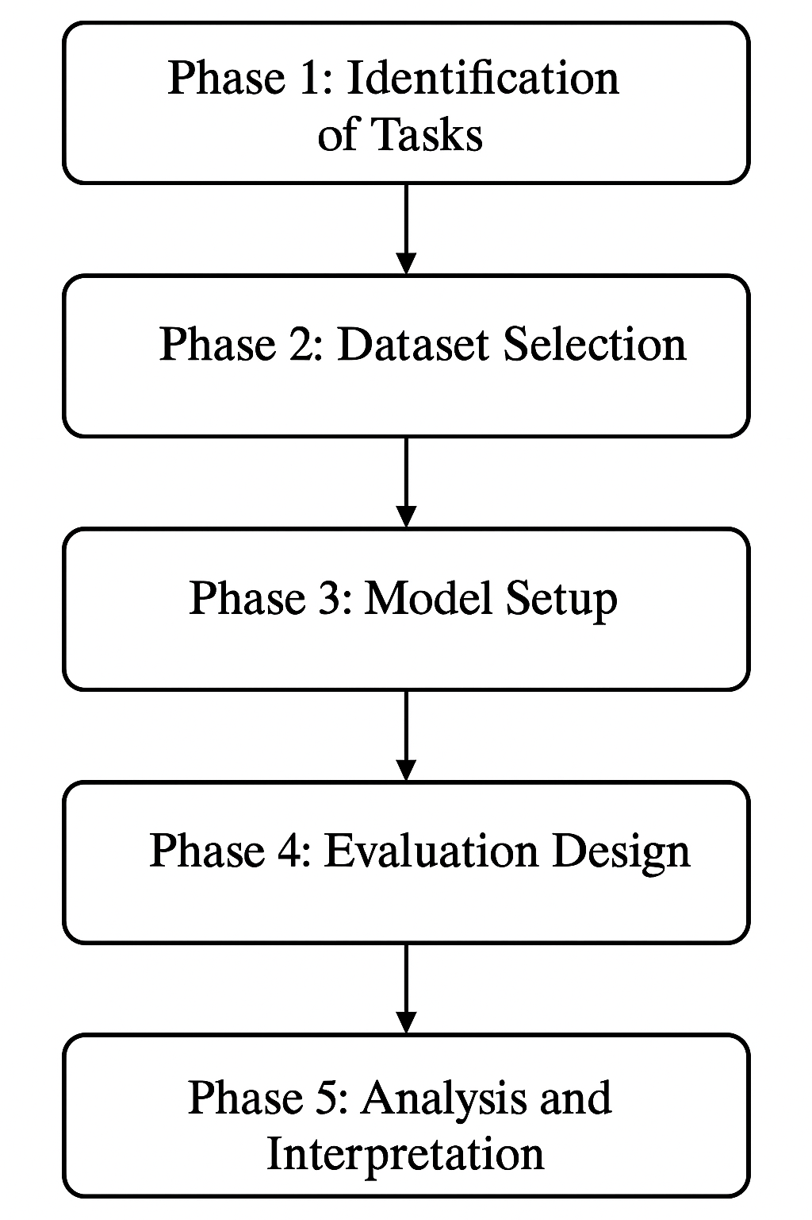
Methodology
Tasks:
Medical QA.
Clinical note summarisation.
Datasets: MedMCQA, PubMedQA.
Models: ChatGPT, Grok, ChatDoctor, BioGPT, etc.
Evaluation: BLEU, ROUGE, F1-score, self review.

Slide 10
Research Progress
Setpoints
Datasets (MedMCQA, PubMedQA) identified.
LLMs: ChatGPT, Grok, Gemini, LLaMa, ChatDoctor, BioGPT.
Tried comparing ChatGPT, GROK, ChatDoctor.
Pending Works:
Implementation & Evaluation
Comparison and Analysis

Slide 11
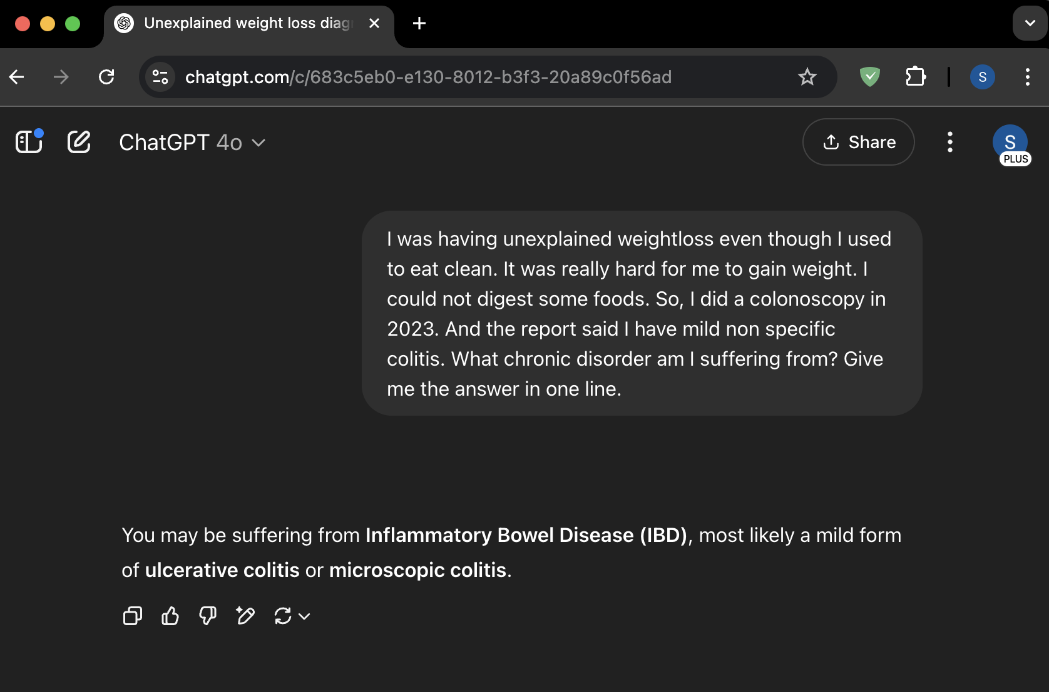
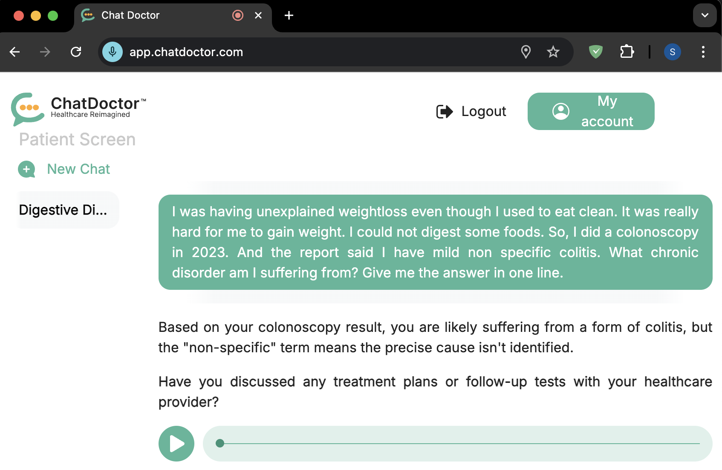
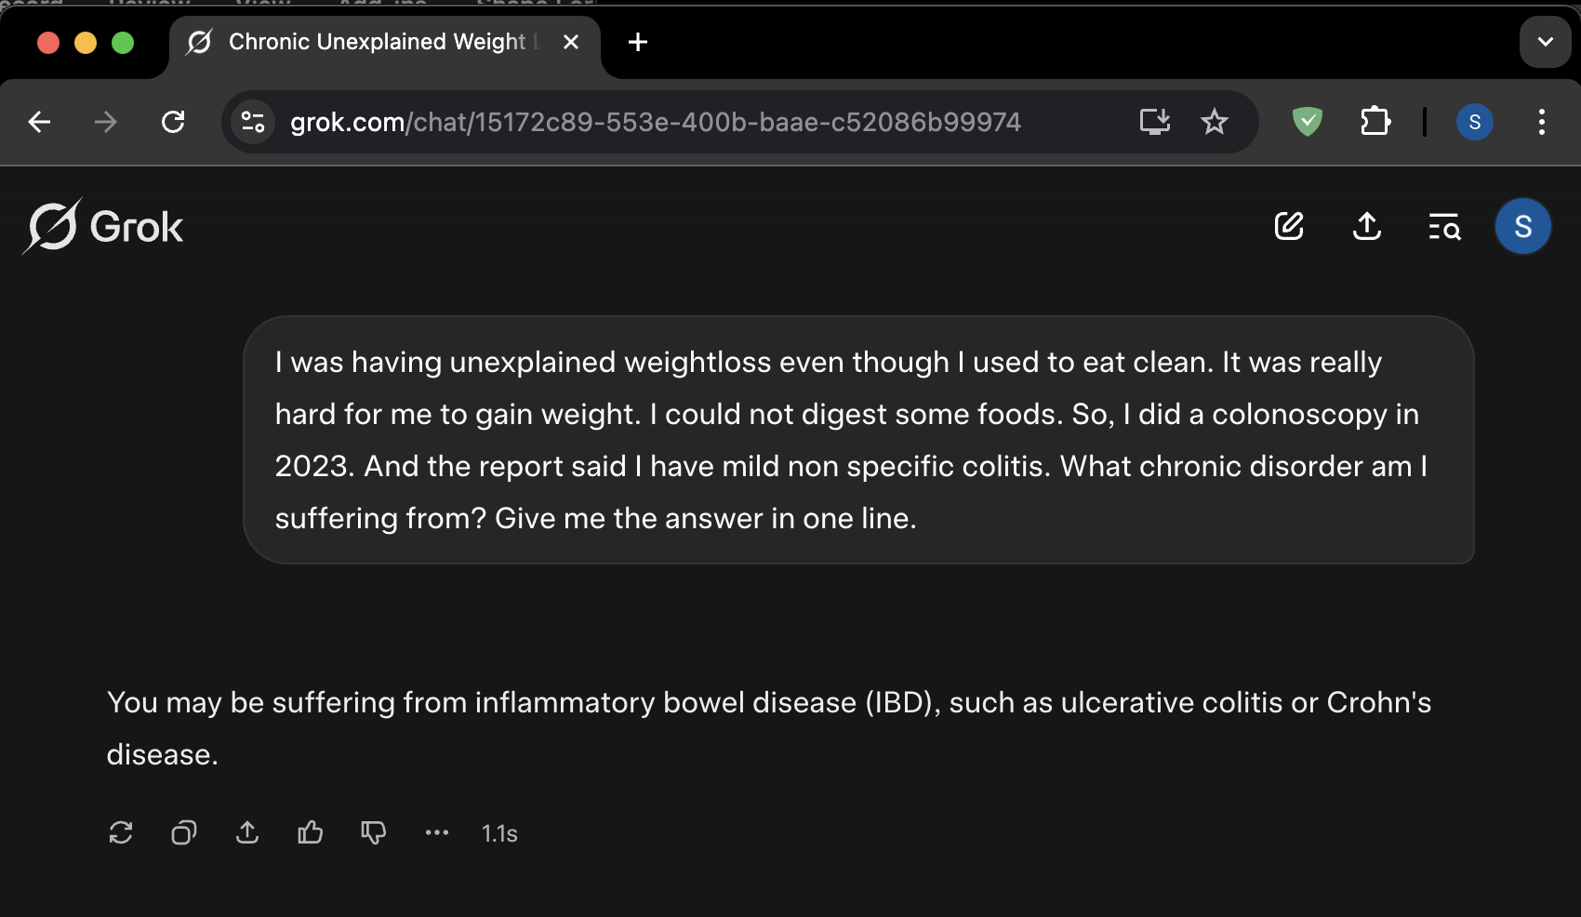
Initial Implementation
ChatGPT
ChatDoctor
GROK

Slide 12
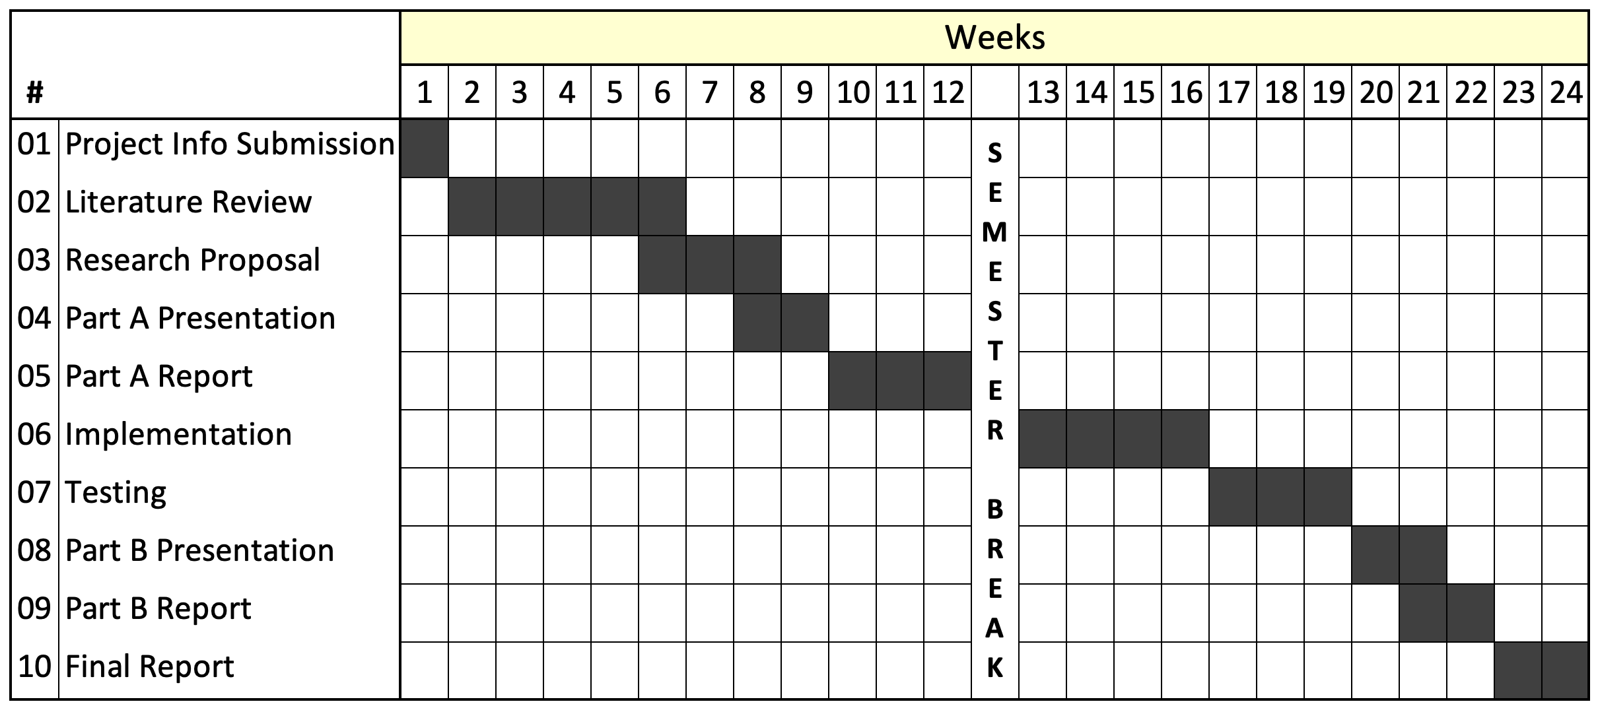
Timeline

Slide 13
Future Work
Implementing testing setup
Full testing of all models.
Analyse the strengths, failures and risks of each models.
Recommendations for real-world use.

Slide 14
Thank You!

